Slide 1
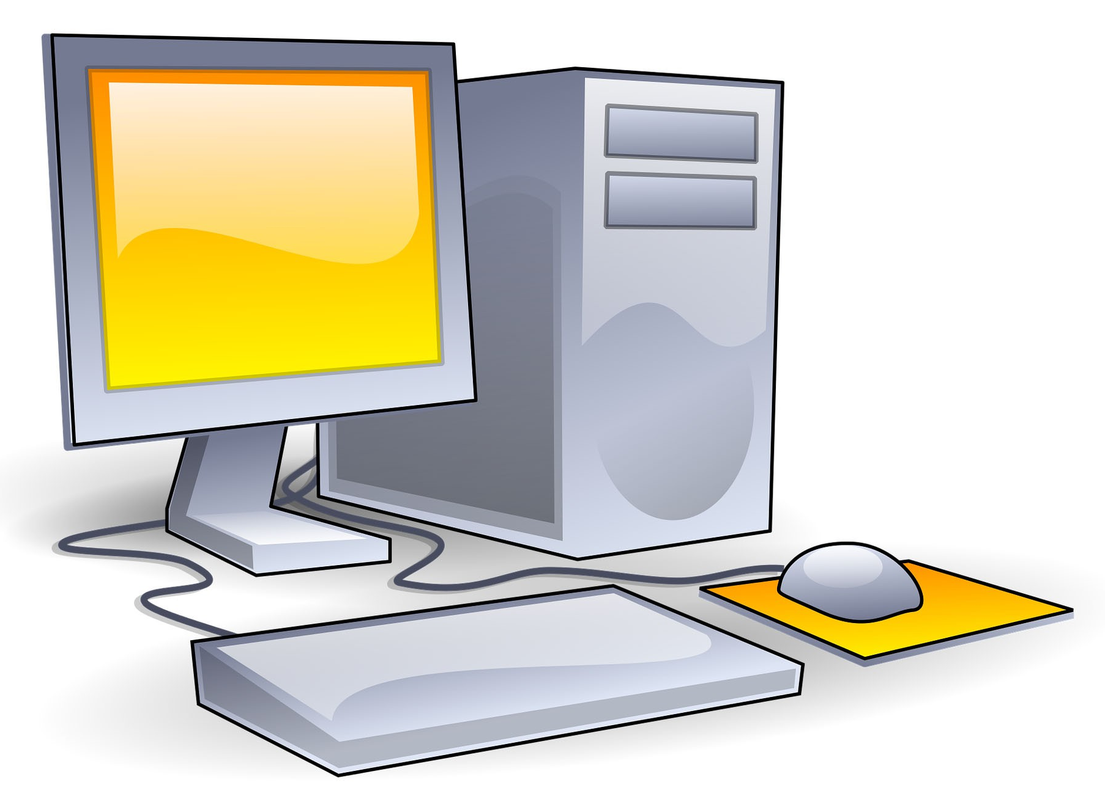
Semiotics
bla, bla, bla
What has language to do with computer science?
Applied Research and Innovation in Computer Science
Dipl.-Ing. Hubert Schölnast, BSc.
WS 2021/22

Slide 2
Languages
Languages consist of signs which, when linked together, can describe something, and can be understood (interpreted) by someone.
Syntax
signs
Semantics
Pragmatics
object
interpreter

Slide 3
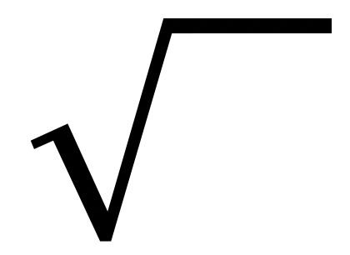
Signs
A sign is something that designates something else. The sign itself is not the thing that it depicts and the sign itself has no meaning. It needs to be interpreted to mean something.
4
漢
Ⱘ
🥱
Ӛ
“
(
ख
A

Slide 4
Syntax
Syntax is a set of rules that define the way signs may be arranged and connected to each other.
In formal systems, syntax is a set of rules that specifies how pre-existing groups of signs may be transformed into other, new groups of signs.
Syntax does not care about the objects to witch single signs or groups of signs refer.
Syntax does not care about the meaning that an interpreter might see in the group of signs.

Slide 5
Syntax, an example
Our language has 8 words:
a, big, cat, guitar, plays, sleeps, small, the
And there are also 6 phrases:
adjective, article, nominal_group, noun, sentence, verb
One of these phrases is the starting phrase:
sentence
Now we only need some rules

Slide 6
Syntax, an example
Rules
Rule 1: | sentence | → | nominal_group verb
Rule 2: | nominal_group | → | article noun | article adjective noun
Rule 3: | article | → | the | a
Rule 4: | adjective | → | big | small
Rule 5: | noun | → | guitar | cat
Rule 6: | verb | → | sleeps | plays

Slide 7
Syntax, an example
sentence
rule 1
nominal_phrase verb
rule 2
rule 6
article adjective noun
rule 3
rule 4
rule 5
the
big
cat
sleeps

Slide 8
Syntax, an example
Other valid sentences:
a guitar plays
the cat sleeps
a small cat plays
the big guitar sleeps
Invalid sentences:
a cat plays the guitar
the guitar cat sleeps
plays sleeps a the guitar big
the cat plays
a small guitar sleeps
the guitar plays
a guitar sleeps
to be or not to be
where is the cat?
meow

Slide 9
Syntax
Syntax appears in natural languages
in spoken language as phonetic rules
The “signs” are single sounds (in linguistics: “phonemes”)
some sequences of phones are possible, others are not
in written language as orthography
The signs are single characters
phone – character – matching
some sequences of characters are possible, others are not
in both as grammar
The “signs” are single words
some sequences of words are possible, others are not
between orthography and grammar is another layer (morphemes)
on higher levels there is a syntax of story telling. The signs from which you can build dramas are acts, there are rules for their sequence.

Slide 10
What is a sign?
This depends on the definition of the term “sentence”.
“sentence” or “word” “sign”
a spoken word
a written word
a mathematical formula
sentence of a natural language
source code of a computer program
score of an opera
DNA
a sound (“phoneme”)
a letter
numbers, operators, etc.
word stems, word endings, blanks, interpunctuation
keywords, special characters, letters, etc.
staves, bar lines, notes, etc.
nucleotides

Slide 11
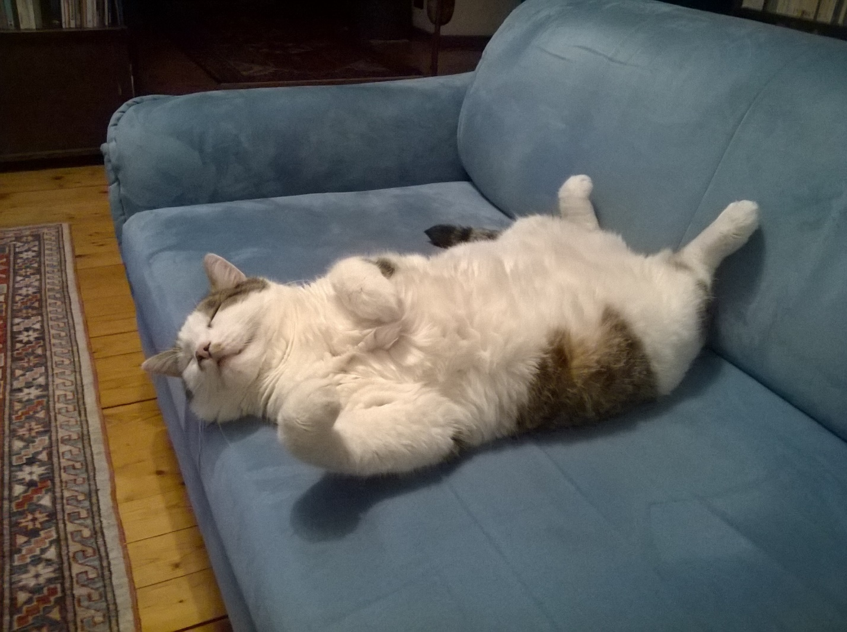
Semantics
Semantics is the process that connects the signs (or groups of signs) to real things.
the big cat sleeps
semantics

Slide 12
Semantics
Semantics describes the relationship of signs or groups of signs to reality.
Semantics investigates whether linguistic expressions are true, false or without meaning.
the big cat sleeps
can be true or false
Semantics can only assign meaning to syntactically correct collections of signs
plays sleeps a the guitar big
has no meaning

Slide 13
Pragmatik
Pragmatics studies the relationship of language to the speaker and the addressee.
The interpretation of signs often differs between different listeners of the same message. But it also often differs between sender and receiver.
Semantics is about what the signs really mean.
Pragmatics is about how the sender, or the receiver of a message understands it.

Slide 14
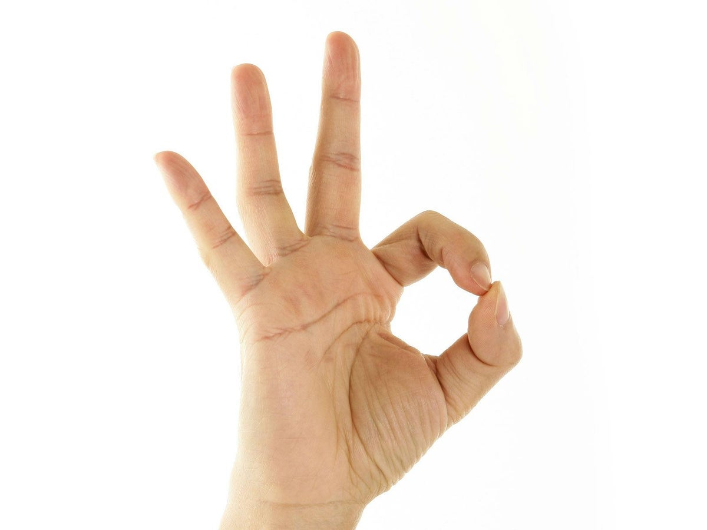
Pragmatics
The same sign can be interpreted by different interpreters in different ways
For divers under water “everything is ok”
Some people see in it a human anus
For racists: “white power”

Slide 15
Pragmatics
Correct piece of code in C programming language:
a = 2
b = 5
c = a+++b
printf("a=%i, b=%i, c=%i",a,b,c)
The 3rd line can be interpreted in two different ways
c = a++ + b
first calculate the sum of a and b, assign it to c then increment a by 1 (“post-increment”) output: a=3, b=5, c=7
c = a + ++b
first increment b by 1 (“pre-increment”) then calculate the sum of a and b and assign it to c output: a=2, b=6, c=8

Slide 16
Pragmatics
In computer science, attempts are almost always made to keep the influence of pragmatics, i.e., the scope for interpretation, to a minimum and, if possible, to avoid it completely.
Pragmatics will not be a topic for the rest of this course.

Slide 17
Syntax vs. Semantics
Be always aware that there is a big difference between syntax, which does not know anything about the meaning of signs, and semantics, which deals with the meaning of signs.
The spell checker of your word processor has no idea of the meaning of the words you wrote. It works exclusively on the syntactic level.
If in the course you are asked to focus only on the syntax of strings, think of this spell checker, which also completely ignores the meaning of the characters.

